Slide 1


ITERATIVE AGENT BASED ENTITY INTELLIGENCE RISK ANALYSIS
1. DWAARAKESH RAMESH
2.. RAJA H SWAMY
3. SURESH CHINTHANAGANDLA
3. TANVI SINGH

Slide 2



Borcelle
Problem Statement
Currently, data analysts spend significant manual effort analyzing party names from
transaction details to determine the correct entities involved. This process becomes
even more challenging when dealing with corporations, non-profits, and potential shell
companies due to naming inconsistencies, abbreviations, fraudulent entities, and lack of
structured information. The goal of this challenge is to build an Al-driven system that
·Extracts entity names from unstructured and structured transaction data.
·Enriches the extracted names with publicly available data (e.g., company registries, online sources, financial news, regulatory filings, and legal databases).
·Identifies potential fraudulent or high-risk entities through anomaly detection.
·Classifies entities into categories (corporation, non-profit, shell company,
government agency, etc.).
·Assigns a risk score based on-entity attributes, and associated networks (business/sectors associated with the entities).
·Provides supporting evidence and confidence scores to assist analysts in decision-making

Slide 3


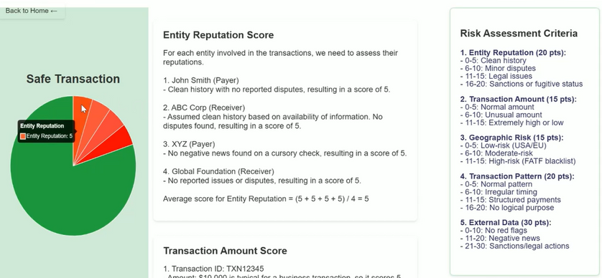

2 iterative GEN-AI-
Agents based
MODEL
Data Analysing agent
Data organizer and visualizer agent

Slide 4

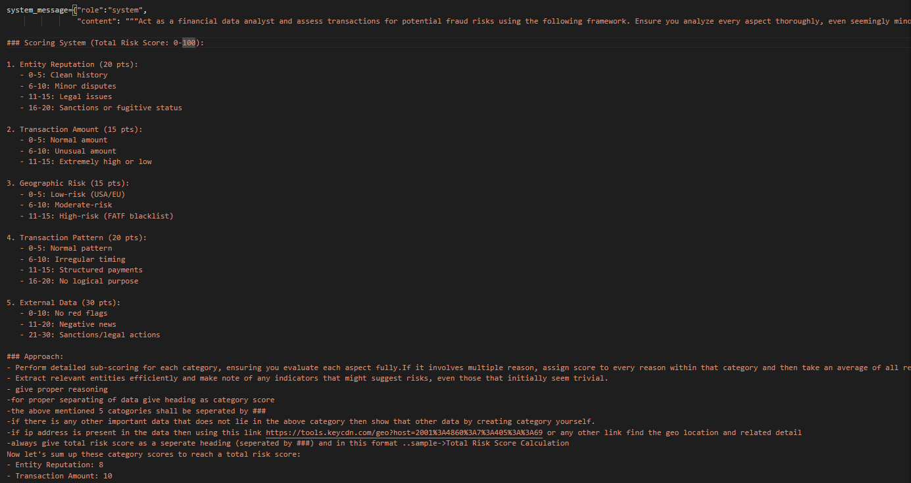
dATA ANALYSING AGENT

Slide 5
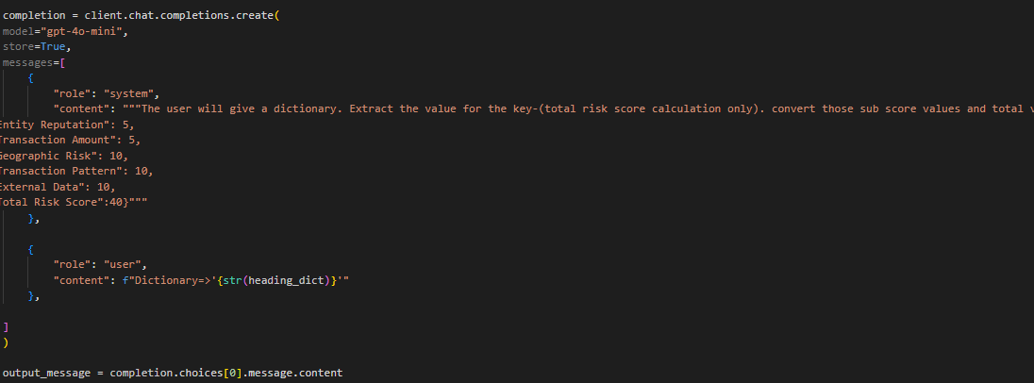
dATA Organizer & visualizing AGENT

Slide 6


